Slide 1
Async Masterclass
Way more than you ever wanted to know. Unless you have an insatiable thirst for knowledge.
In which case, this is just one well on your journey.

Slide 2


Slide 3


Slide 4
Who is this guy?
Notes:
Available for contract work!
Microsoft MVP
Top async/await answerer on Stack Overflow
Assisted hundreds of companies with async adoption across all kinds of applications (available for contract work!)
Blog has been the go-to source for async advice for years
Contributor of some of the MS documentation on subjects such as ValueTask
Maintainer of AsyncEx, a library with >25M downloads which provides asynchronous coordination primitives and other async helper types (pretty much the subject of today’s talk)

Slide 5


Slide 6
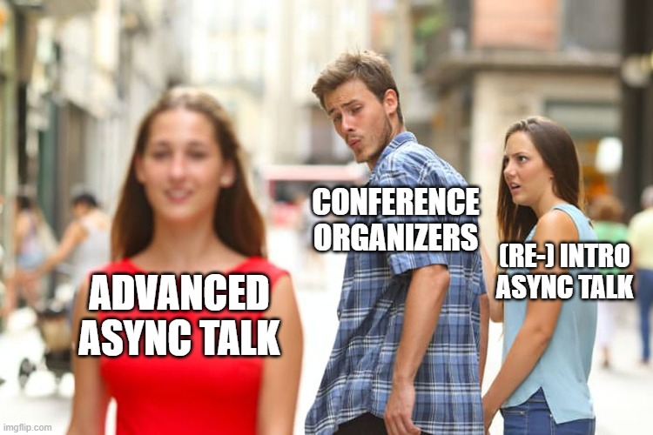
Please do ask questions!

Slide 7
ValueTask

Slide 8
ValueTask History
High-performance code that needs to reduce allocations.
Classic use case: Socket.
First ValueTask was either a synchronous result or Task.
Modern ValueTask can also be an IValueTaskSource (enables pooled / recycled source instances – essentially a reusable Task).
https://tinyurl.com/value-task
Notes:
Socket: APM, SocketAsyncEventArgs, TAP, ValueTask

Slide 9
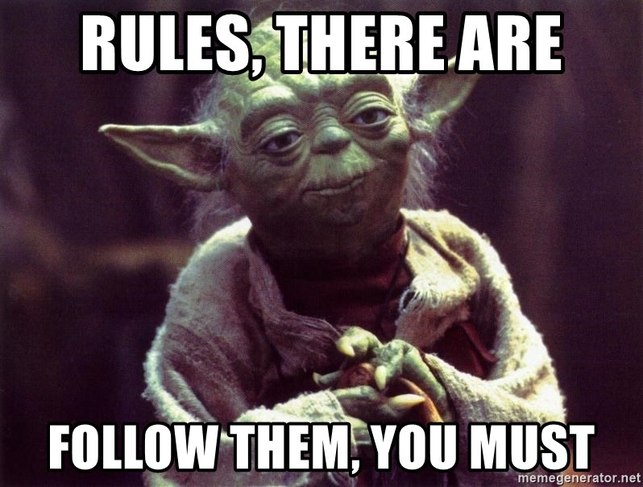
Rules Around ValueTask
Only consume once!
await – the 99% case.
Advanced: IsCompleted for fast path.
Cannot block!
.Result and .GetAwaiter().GetResult() will compile but may fail at runtime.
Even worse, they may work at runtime (block) and then later fail at runtime.
Need to bend the rules? AsTask()

Slide 10
Implementing ValueTask Methods
Producing ValueTasks:
async ValueTask: possibly-synchronous results (.NET Core 1.1).
[AsyncMethodBuilder(typeof(PoolingAsyncValueTaskMethodBuilder<>))]: pooled ValueTask sources (.NET 6).
Mostly outdated:
Constructor: synchronous result or Task wrapper (.NET Core 1.0).
ManualResetValueTaskSourceCore<T> (.NET Core 3.0).
Implements IValueTaskSource<T>
Still useful for extremely performance-sensitive code.

Slide 11
IAsyncDisposable

Slide 12
Asynchronous Disposal
ValueTask DisposeAsync();
Just like Dispose(), just asynchronous.
No official patterns for whether you can (or should) support both, “dispose pattern”, etc.
Not supported everywhere, e.g., AsyncServiceScope is 6.0+
Nito.Disposables if you want helpers.

Slide 13

Asynchronous Disposal: But Y Tho?
Use case: asynchronous streams (IAsyncEnumerable)

Slide 14
Async Streams
Type | Usage
T | Synchronous, single value.
IEnumerable<T> | Synchronous, multiple values.
Task<T> | Asynchronous, single value.
IObservable<T> (or events) | Asynchronous, multiple values, pushed.
IAsyncEnumerable<T> | Asynchronous, multiple values, pulled.

Slide 15
AsyncLocal<T>

Slide 16
AsyncLocal: Use Case
Implicit data with lexical scoping.

Slide 17
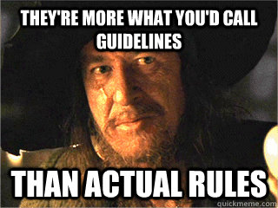
AsyncLocal: Guidelines
Use using to make scopes explicit.
Use immutable types.
There’s a difference between modifying the value and setting the value.
Use sparingly!
Implicit data is too magical. E.g., culture.
Similar drawbacks as global variables.

Slide 18
AsyncLocal: Details
Flowed by ExecutionContext
Pre-Core: part of LogicalCallContext vs IllogicalCallContext
Core: ExecutionContext
async methods shallow-copy their scope at beginning of method
Reason for immutable guideline.
Nested contexts, except every non-async method lives in its parent context (!)
Reason for using guideline.
Context always flows “down,” never “up”.
https://tinyurl.com/toub-async
https://tinyurl.com/asynclocal

Slide 19
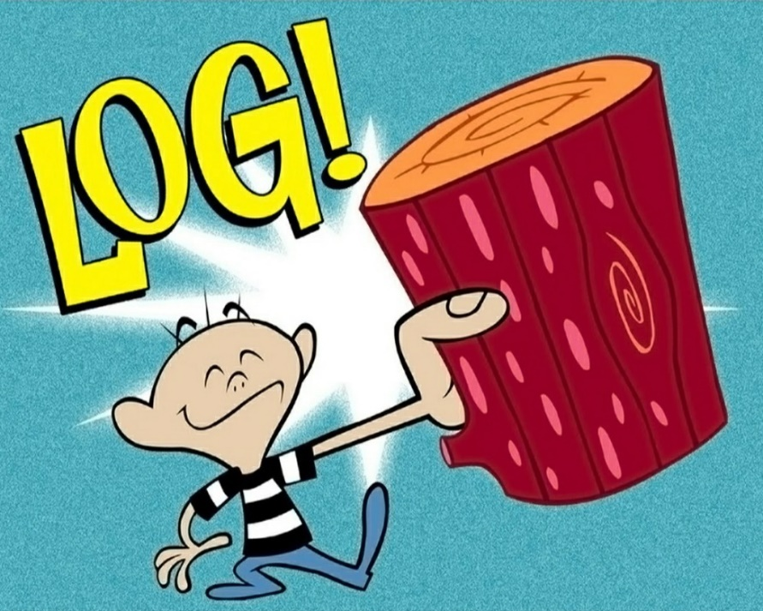
AsyncLocal: Primary Use Case
Attaching contextual data to log messages.

Slide 20
AsyncLocal: Primary Use Case: Pitfall
Exception logging.
How does ASP.NET middleware actually work?
How does exception logging middleware work?
Solution: throw context enrichers.

Slide 21
Channels

Slide 22
Channels: Async Producer/Consumer Queues
Replaces hand-grown or TPL Dataflow.
Consumer: ReadAllAsync.
Producer: WriteAsync + Complete.
Bounded for backpressure.

Slide 23


Slide 24
PauseToken

Slide 25
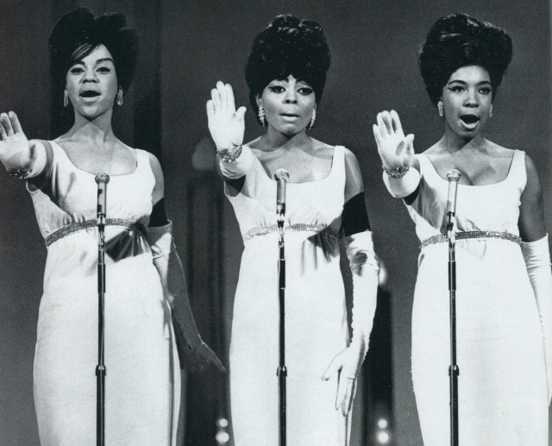
PauseToken: Desired Semantics
Pause / Unpause
WaitWhilePausedAsync
Can split into “source” (controller) and “token”, similar to CTS.

Slide 26
PauseToken: Recognized API Pattern
Similar to ManualResetEvent!
Event: A thing that is “signalled” or “unsignalled” and enables waiting for it to become signalled.
ManualReset: An event that is manually set (=> signalled) or reset (=> unsignalled).
Plan: build AsyncMRE first; then build PT+PTS.

Slide 27
PauseToken: Strategy
PauseToken Semantics | ManualResetEvent Semantics
Pause() | Reset()
Unpause() | Set()
WaitWhilePausedAsync() | WaitOne() /* Wait until set */

Slide 29
PauseToken Implementation
Tricksy parts:
Never invoke end-user code while holding a lock.
TCS.TrySetResult (and friends) and CTS.Cancel are invocations of end-user code!

Slide 30
TCS Dictionary

Slide 31
TCS Dictionary: Desired Semantics
Common situation: multiple requests and replies, where replies may not be in request order.
Solution: TCS dictionary.
Operations: Insert, Remove-And-Complete.
Always complete your tasks!

Slide 33

TCS Dictionary: Worked Example
Building a TCP/IP client/server that uses ValueTask Socket methods, System.IO.Pipelines, Channels, and a TCS dictionary all together.
https://tinyurl.com/async-tcp

Slide 34
AsyncLazy<T>

Slide 35
AsyncLazy: Simplicity
Easy solution (Lazy<Task<T>> with GetAwaiter)

Slide 36
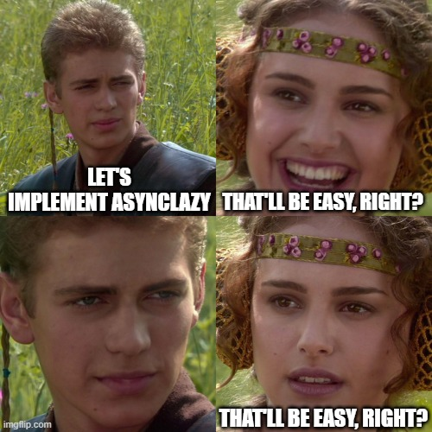
AsyncLazy: Complexity
Complex:
How to execute delegate?
Exceptions are cached.
Should we also reset on demand?
At this point it becomes a single-item cache.
https://tinyurl.com/asynclazy-considerations

Slide 37
Async Caching

Slide 38
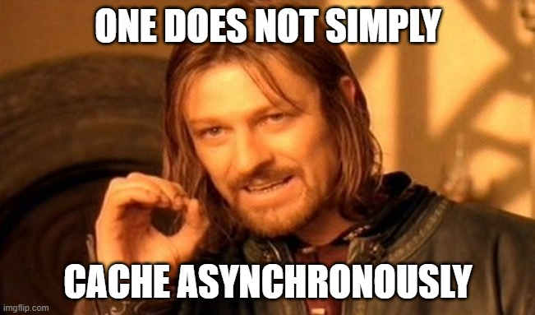
Asynchronous Caching.
Cache Task<T>, not its result.
IMemoryCache.GetOrCreateAsync exists but may not do what you want.
Must be in-memory. Task isn’t serializable in the general case.
Similar problems as AsyncLazy<T>: caching exceptions.
Removed/updated in cache before completed?
Don’t know eviction parameters until completed? (JWT)
Solution: cache TaskCompletionSource<T>.
https://tinyurl.com/async-cache

Slide 39
Q&A

Slide 40


https://that.land/3JT49Cy

